Slide 1
marketing_campaign Tableau visulation
File created on: 20/11/2022 21:51:19

Slide 2
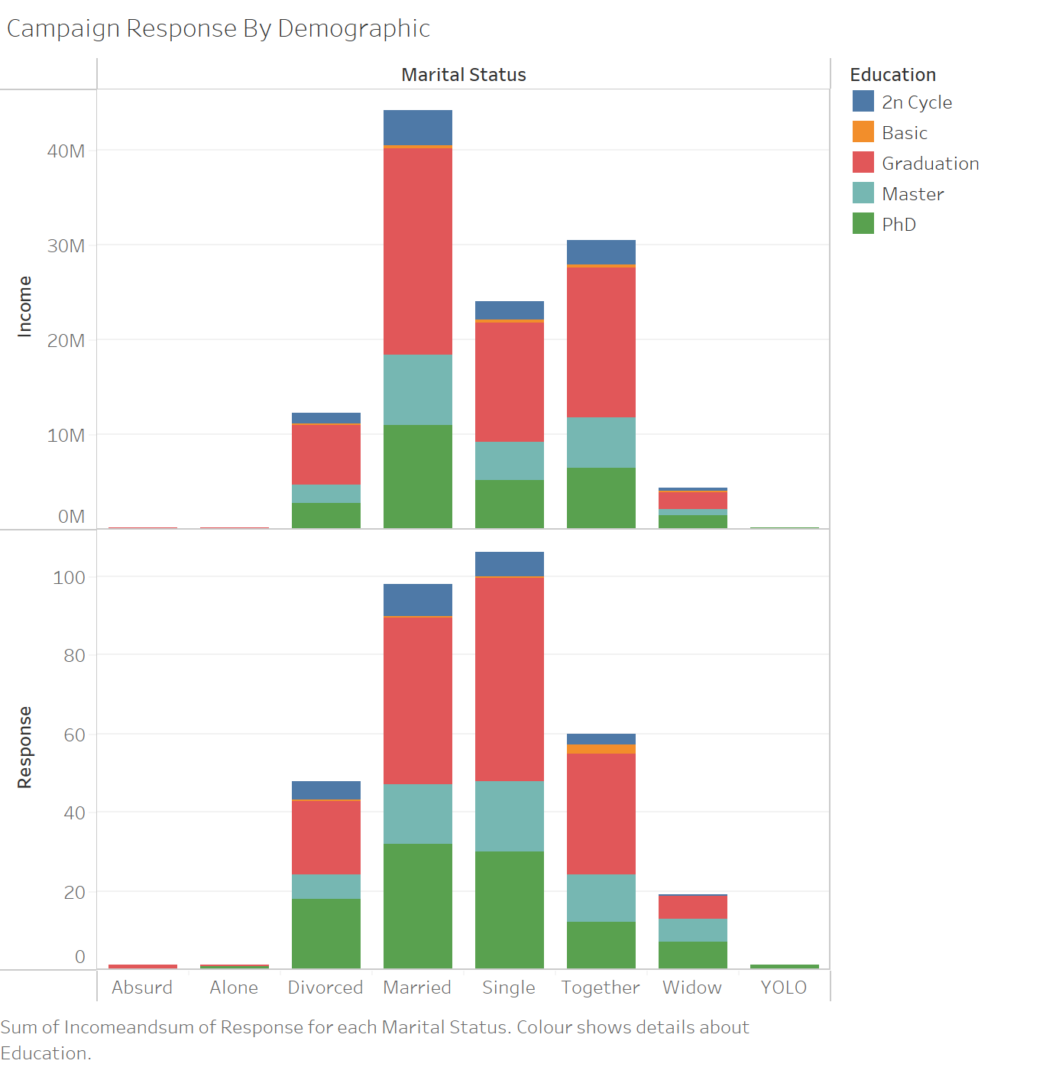

Slide 3
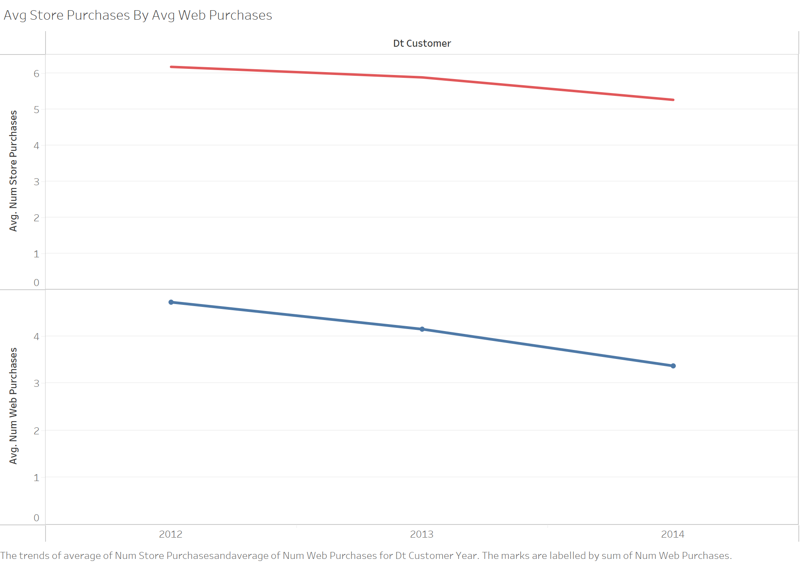

Slide 4
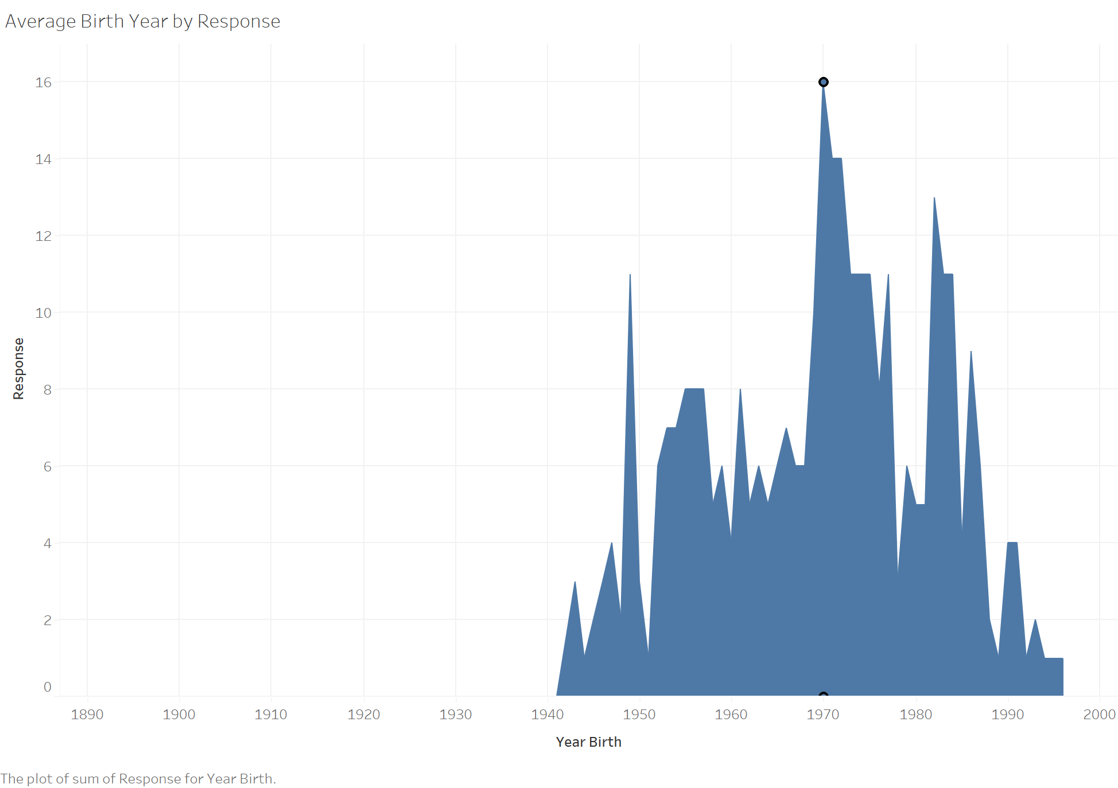

Slide 5
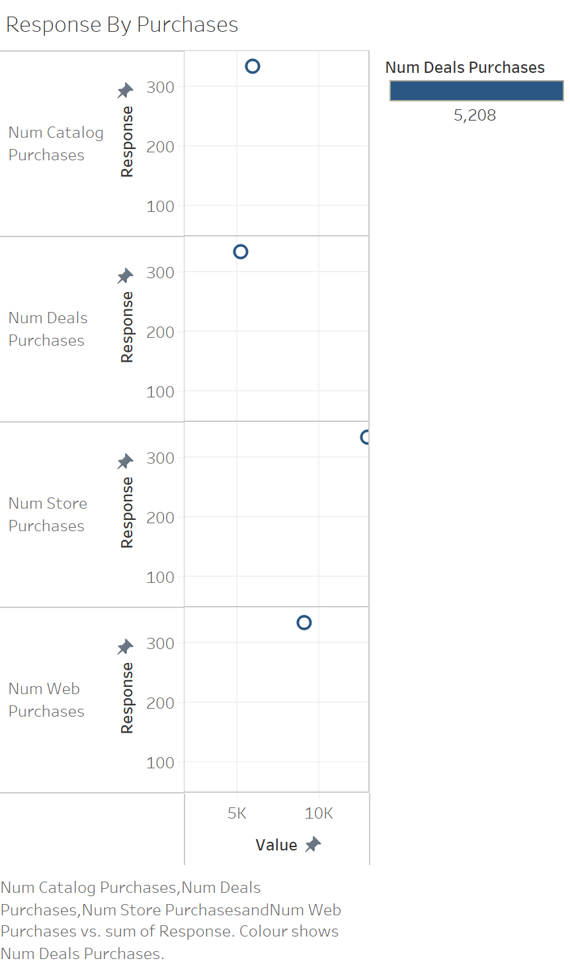

Slide 6
